Slide 1
Monday, 2/14/22
Any Questions?
Project 2
postfixToInfix | ab+ → a+ b // no need to worry about parentheses
Project 1 | My Grades
Exam 1 | Modules 1 - 10
Topics
Module 10 | Lists
Module 9 | Recursion

Slide 2
Studying STEM (CMSC)
Why are you studying CMSC (or majoring in STEM)?
https://triplebyte.com/blog/getting-job-ready-while-pursuing-a-cs-degree
Chunk your logic as much as possible
Pursue project-based work
Project-oriented electives
Map the abstract to the real world
Open-source contribution
Use git for everything
My experience
IT Project Manager
class structures

Slide 3
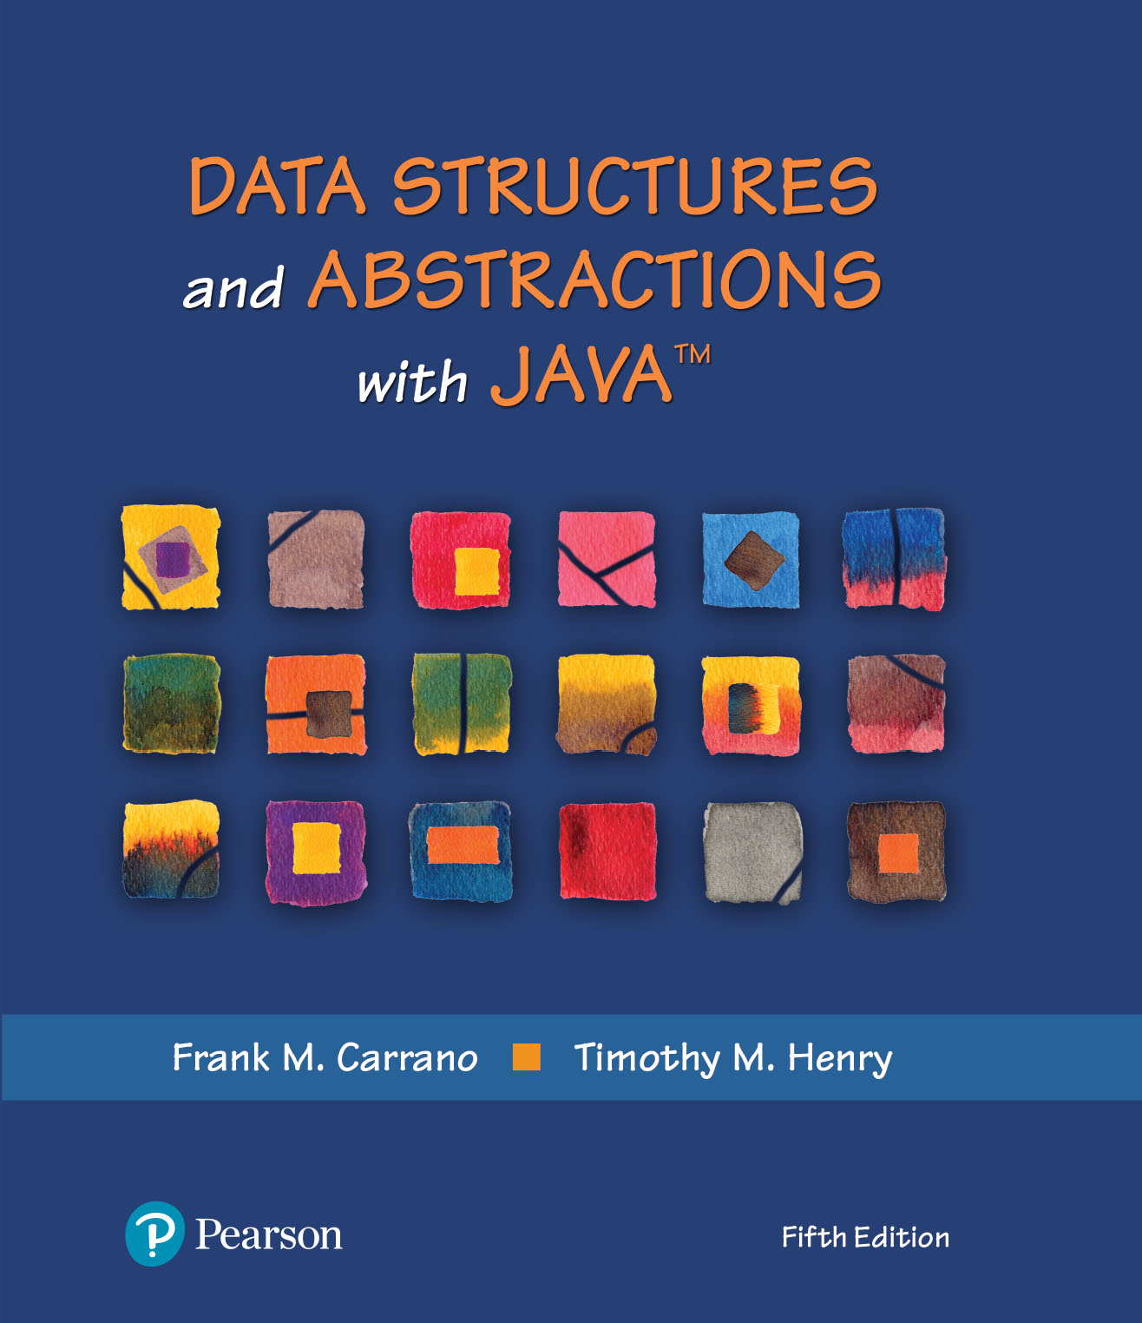
ADT List
Chapter 10 | Lists
Chapter 11 | Array Based
Chapter 12 | Linked Data
What ADTs have we learned thus far?
Notes:
Bag
Stack, Queue

Slide 4
Video Notes
The ADT List
https://mediaplayer.pearsoncmg.com/assets/secs-vn-ch10a-the-adt-list
Using the ADT List
https://mediaplayer.pearsoncmg.com/assets/secs-vn-ch10b-using-the-adt-list
An Array-based ADT List
https://mediaplayer.pearsoncmg.com/assets/secs-vn-ch11a-an-array-based-adt-list
Completing the AList Class
https://mediaplayer.pearsoncmg.com/assets/secs-vn-ch11b-completing-the-alist-class
A Linked-based ADT List
https://mediaplayer.pearsoncmg.com/assets/secs-vn-ch12a-a-link-based-adt-list
Completing the Class List
https://mediaplayer.pearsoncmg.com/assets/secs-vn-ch12b-completing-the-class-list
Notes:
To maximize your learning experience, prepare for class prior each week

Slide 5

Lists
A way to organize data
Examples
To-do list
Grocery Lists
Items in list have position
May or may not be important
Items may be added anywhere

Slide 6
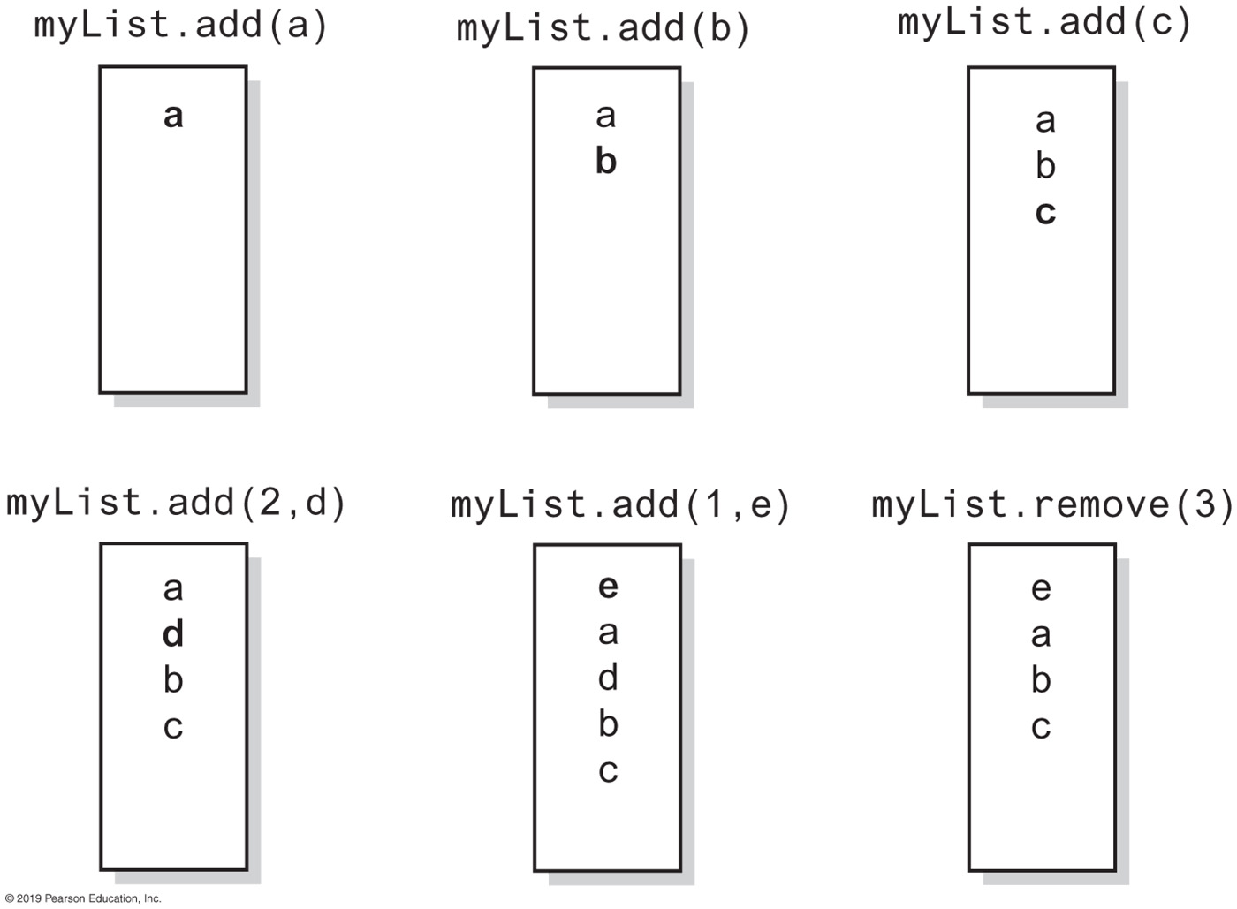
List Specifications
Notes:
List starts at position 1

Slide 7
ADT List | Operations
add(newEntry)
add(newPosition, newEntry)
remove(givenPosition)
clear()
replace(givenPosition, newEntry)
getEntry(givenPosition)
contains(anEntry)
getLength()
isEmpty()
toArray()

Slide 8
The interface ListInterface (1 of 3)
** An interface ADT list. Entries in a list have positions that begin with 1. */
public interface ListInterface<T> {
/** Adds a new entry to the end of this list.
Entries currently in the list are unaffected.
The list's size is increased by 1.
@param newEntry The object to be added as a new entry. */
public void add(T newEntry);
/** Adds a new entry at a specified position within this list.
Entries originally at and above the specified position
are at the next higher position within the list.
The list's size is increased by 1.
@param newPosition An integer that specifies the desired
position of the new entry.
@param newEntry The object to be added as a new entry.
@throws IndexOutOfBoundsException if either
newPosition < 1 or newPosition > getLength() + 1. */
public void add(int newPosition, T newEntry);
/** Removes the entry at a given position from this list.
Entries originally at positions higher than the given
position are at the next lower position within the list,
and the list's size is decreased by 1.
@param givenPosition An integer that indicates the position of
the entry to be removed.
@return A reference to the removed entry.
@throws IndexOutOfBoundsException if either
givenPosition < 1 or givenPosition > getLength(). */
public T remove(int givenPosition);

Slide 9
The interface ListInterface (2 of 3)
/** Removes all entries from this list. */
public void clear();
/** Replaces the entry at a given position in this list.
@param givenPosition An integer that indicates the position of
the entry to be replaced.
@param newEntry The object that will replace the entry at the
position givenPosition.
@return The original entry that was replaced.
@throws IndexOutOfBoundsException if either
givenPosition < 1 or givenPosition > getLength(). */
public T replace(int givenPosition, T newEntry);
/** Retrieves the entry at a given position in this list.
@param givenPosition An integer that indicates the position of
the desired entry.
@return A reference to the indicated entry.
@throws IndexOutOfBoundsException if either
givenPosition < 1 or givenPosition > getLength(). */
public T getEntry(int givenPosition);
/** Retrieves all entries that are in this list in the order in which
they occur in the list.
@return A newly allocated array of all the entries in the list.
If the list is empty, the returned array is empty. */
public T[] toArray();
/** Sees whether this list contains a given entry.
@param anEntry The object that is the desired entry.
@return True if the list contains anEntry, or false if not. */
public boolean contains(T anEntry);

Slide 10
The interface ListInterface (3 of 3)
/** Gets the length of this list.
@return The integer number of entries currently in the list. */
public int getLength();
/** Sees whether this list is empty.
@return True if the list is empty, or false if not. */
public boolean isEmpty();
} // end ListInterface

Slide 11
List | Array Implementation
AList
–list: T[] –numberOfEntries: integer –DEFAULT_CAPACITY: integer –MAX_CAPACITY: integer –integrityOK: boolean
+add(newEntry: T): void +add(givenPosition: integer, newEntry: T): void +remove(givenPosition: integer): T +clear(): void +replace(givenPosition: integer, newEntry: T): T +getEntry(givenPosition: integer): T +toArray(): T[] +contains(anEntry: T): boolean +getLength(): integer +isEmpty(): boolean

Slide 12
Array Implementation (1 of 2)
/**
A class that implements a list of objects by using an array.
Entries in a list have positions that begin with 1.
Duplicate entries are allowed. */
public class AList<T> implements ListInterface<T>
{
private T[] list; // Array of list entries; ignore list[0]
private int numberOfEntries;
private boolean integrityOK;
private static final int DEFAULT_CAPACITY = 25;
private static final int MAX_CAPACITY = 10000;
public AList()
{
this(DEFAULT_CAPACITY);
} // end default constructor
The class AList
Notes:
Alist(); // constructor, just like a bag

Slide 13
Array Implementation (2 of 2)
public AList(int initialCapacity)
{
integrityOK = false;
// Is initialCapacity too small?
if (initialCapacity < DEFAULT_CAPACITY)
initialCapacity = DEFAULT_CAPACITY;
else // Is initialCapacity too big?
checkCapacity(initialCapacity);
// The cast is safe because the new array contains null entries
@SuppressWarnings("unchecked")
T[] tempList = (T[])new Object[initialCapacity + 1];
list = tempList;
numberOfEntries = 0;
integrityOK = true;
} // end constructor
public void add(T newEntry)
{
checkIntegrity();
list[numberOfEntries + 1] = newEntry;
numberOfEntries++;
ensureCapacity();
// add(numberOfEntries + 1, newEntry); // ALTERNATE CODE
} // end add
Notes:
toArray(); // same implementation
add(); // to the end of a list

Slide 14
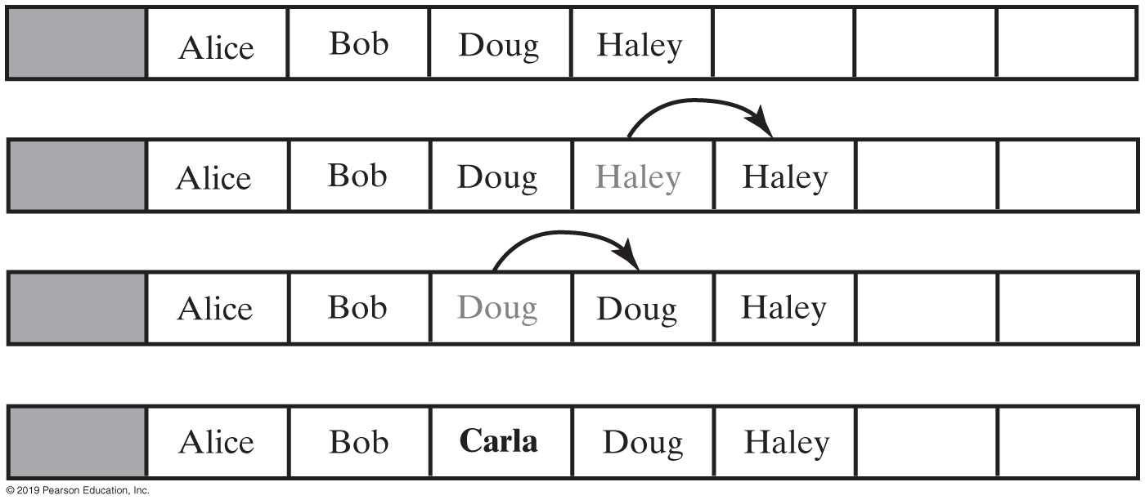
Insert Carla as the 3rd Entry
Adding a new element
add() vs. add(atPos)
What do you notice?
Notes:
Insert() vs. Insert(atPos)

Slide 15
add()
public void add(int givenPosition, T newEntry)
{
checkIntegrity();
if ((givenPosition >= 1) && (givenPosition <= numberOfEntries + 1))
{
if (givenPosition <= numberOfEntries)
makeRoom(givenPosition);
list[givenPosition] = newEntry;
numberOfEntries++;
ensureCapacity(); // Ensure enough room for next add
}
else
throw new IndexOutOfBoundsException(
"Given position of add's new entry is out of bounds.");
} // end add
Add a new entry to a list at a client-specified position
Notes:
makeRoom to insert at the specified position

Slide 16
makeRoom()
private void makeRoom(int givenPosition)
{
int newIndex = givenPosition;
int lastIndex = numberOfEntries;
for (int index = lastIndex; index >= newIndex; index--)
list[index + 1] = list[index];
} // end makeRoom
Method add uses method makeRoom
Notes:
What’s this logic?

Slide 17
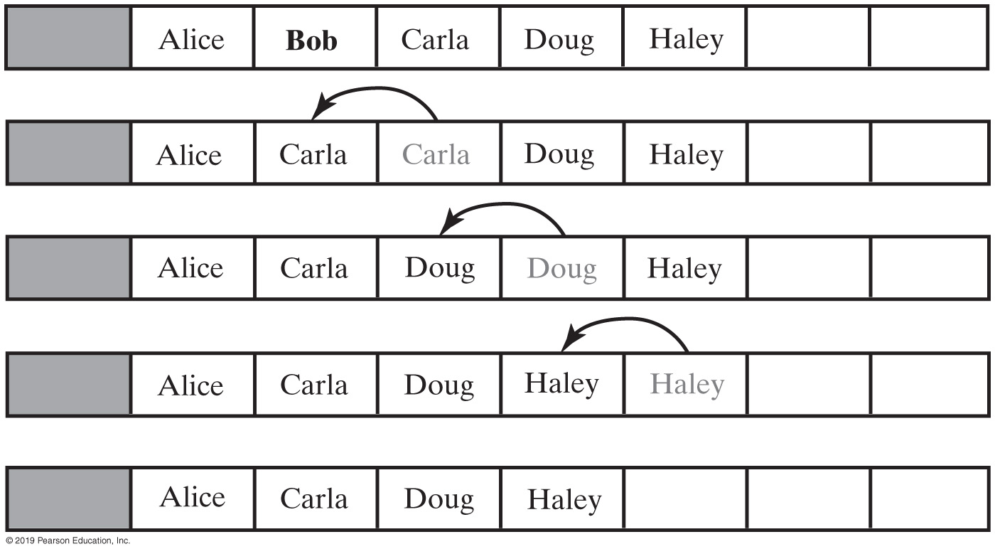
Removing Bob
Removing Bob by shifting array entries
Notes:
Removing Bob

Slide 18
remove()
public T remove(int givenPosition)
{
checkIntegrity();
if ((givenPosition >= 1) && (givenPosition <= numberOfEntries))
{
// Assertion: The list is not empty
T result = list[givenPosition]; // Get entry to be removed
// Move subsequent entries towards entry to be removed,
// unless it is last in list
if (givenPosition < numberOfEntries)
removeGap(givenPosition);
list[numberOfEntries] = null;
numberOfEntries--;
return result; // Return reference to removed entry
}
else
throw new IndexOutOfBoundsException(
"Illegal position given to remove operation.");
} // end remove
Implementation uses a private method removeGap to handle the details of moving data within the array
Notes:
removeGap()

Slide 19
removeGap()
// Shifts entries that are beyond the entry to be removed to the
// next lower position.
// Precondition: 1 <= givenPosition < numberOfEntries;
// numberOfEntries is list's length before removal;
// checkIntegrity has been called.
private void removeGap(int givenPosition)
{
int removedIndex = givenPosition;
for (int index = removedIndex; index < numberOfEntries; index++)
list[index] = list[index + 1];
} // end removeGap
Method removeGap shifts list entries within the array

Slide 20
Array vs. Linked Implementations
Array vs linked implementations
Linked Implementation
Advantages
Avoids moving data when adding or removing entries
Uses memory only as needed
When entry removed, memory returned to system

Slide 21
Adding a Node
We can add a new node anywhere
Chain is empty
Adding node at chain’s beginning
Adding node between adjacent nodes
Adding node to chain’s end

Slide 22
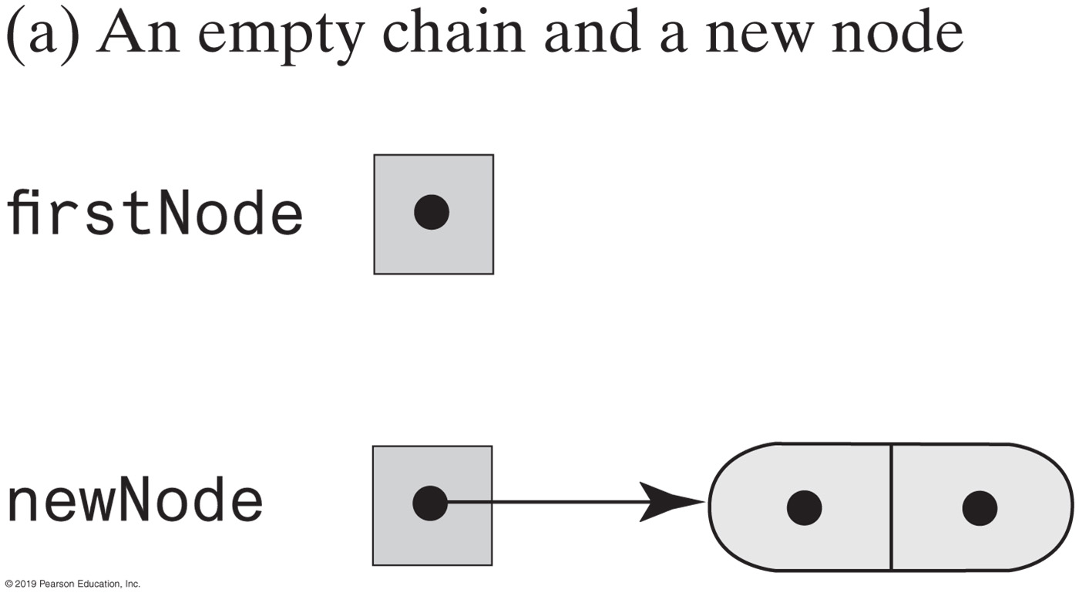
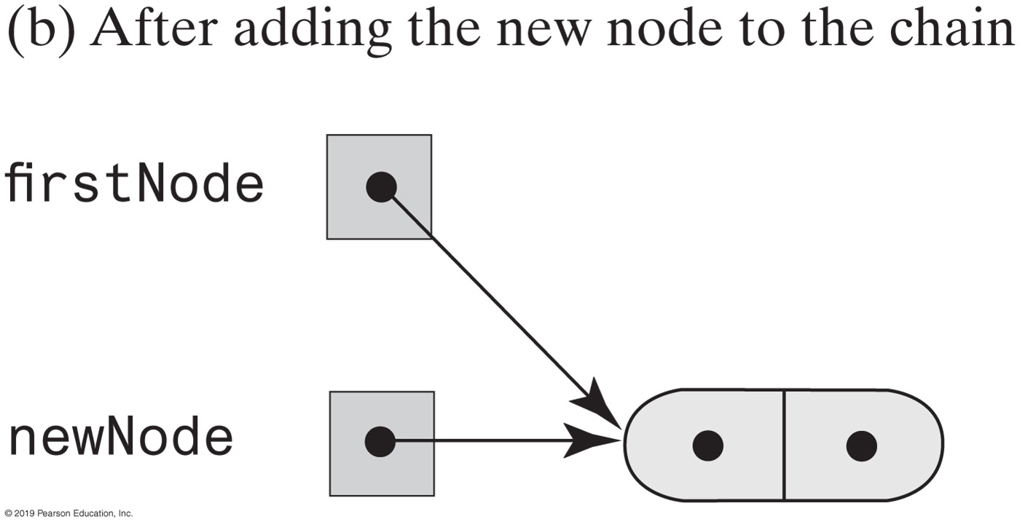
Adding a Node | Empty Chain
Notes:
Just like any linked implementation

Slide 23
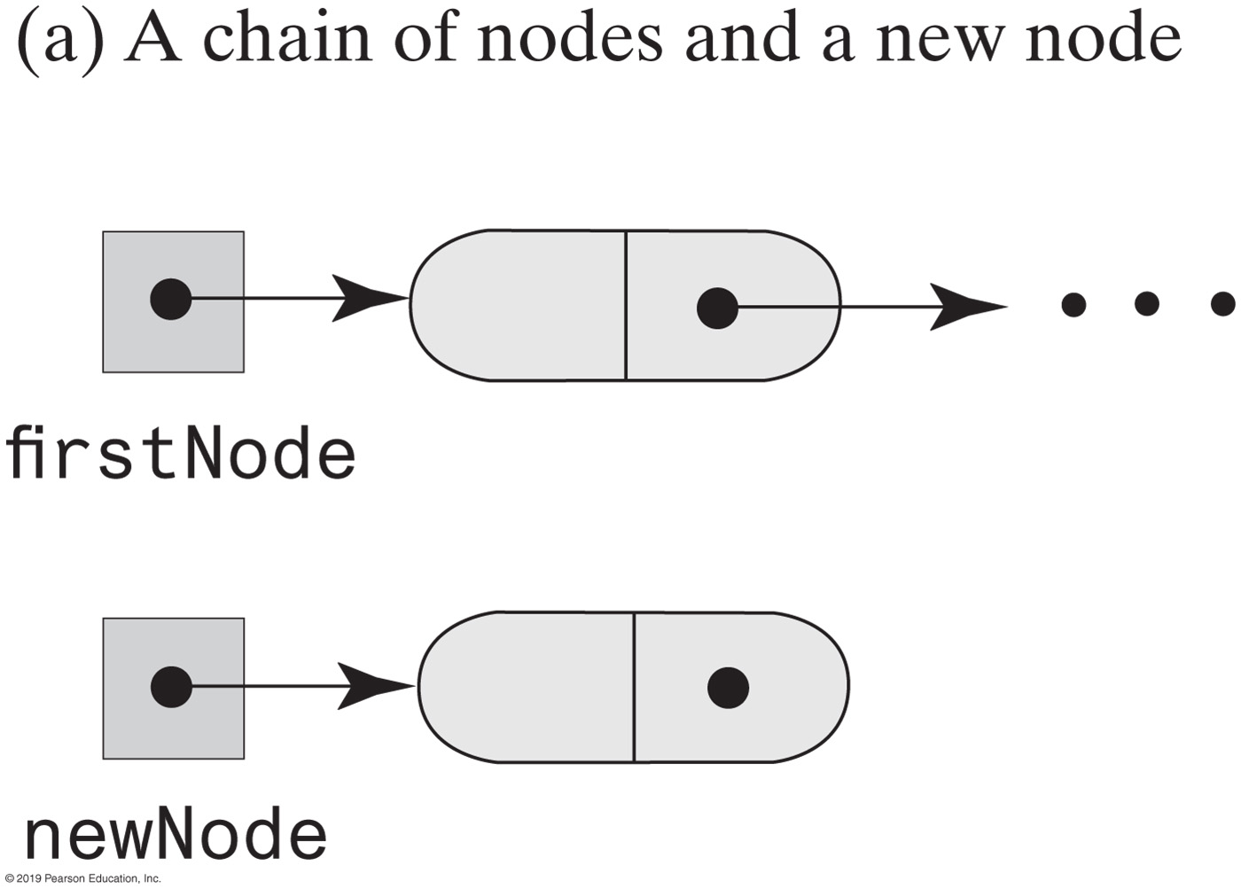
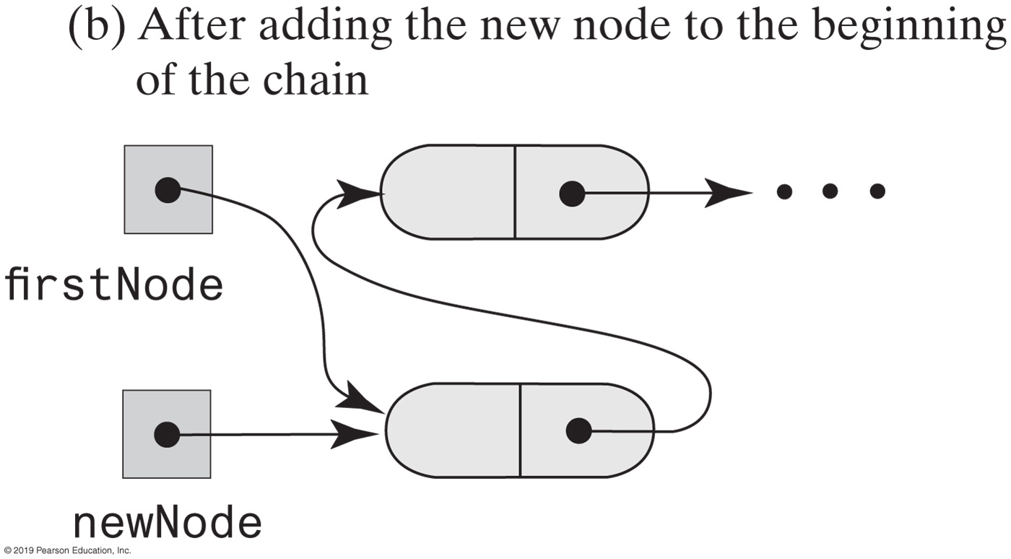
Adding a Node | Beginning of Chain

Slide 24
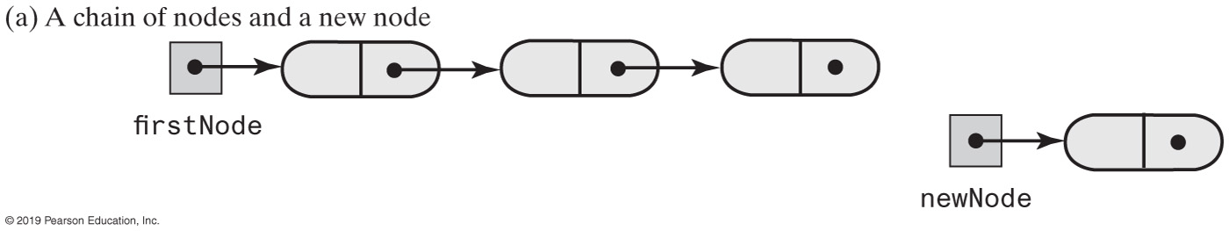
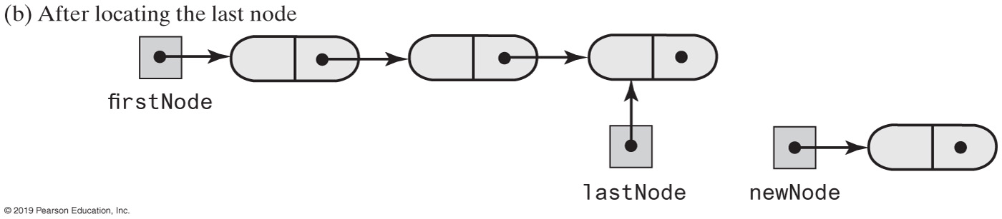
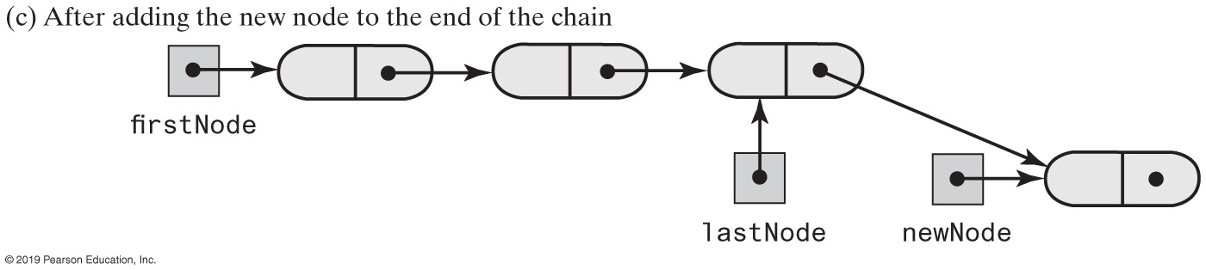
Adding a Node | End of Chain

Slide 25
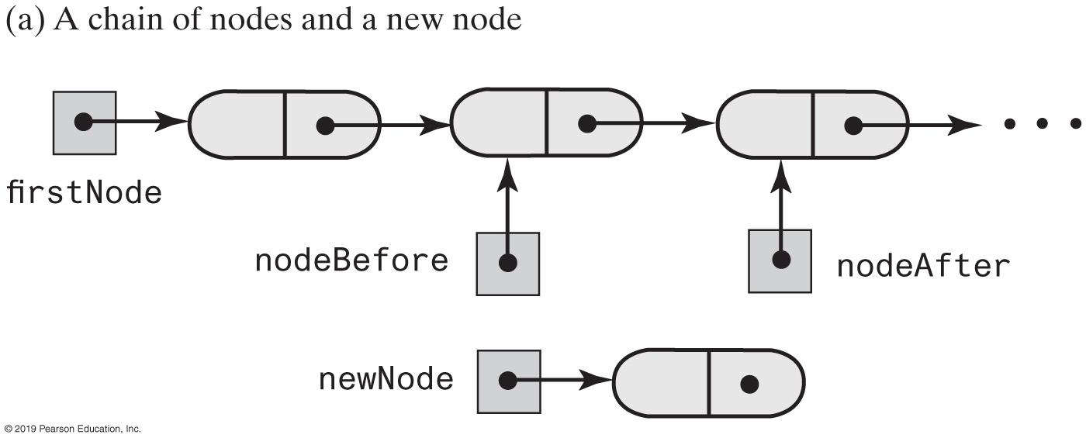
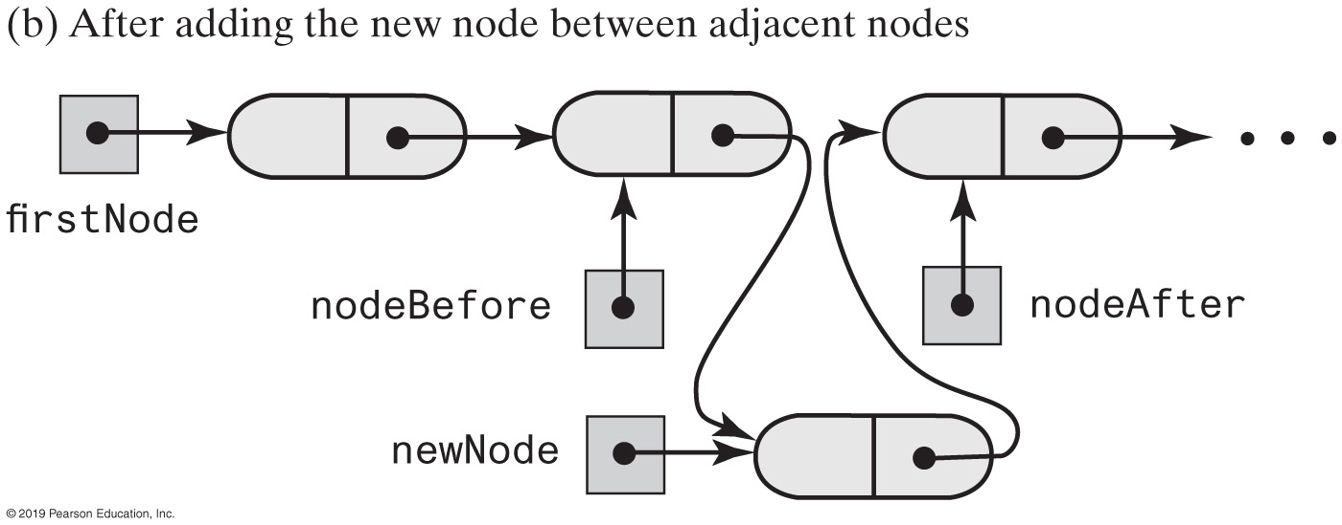
Adding a Node | Between Two Nodes

Slide 26
Adding at a Given Position
public void add(int givenPosition, T newEntry)
{
if ((givenPosition >= 1) && (givenPosition <= numberOfEntries + 1))
{
Node newNode = new Node(newEntry);
if (givenPosition == 1) // Case 1
{
newNode.setNextNode(firstNode);
firstNode = newNode;
}
else // Case 2: list is not empty
{ // and givenPosition > 1
Node nodeBefore = getNodeAt(givenPosition - 1);
Node nodeAfter = nodeBefore.getNextNode();
newNode.setNextNode(nodeAfter);
nodeBefore.setNextNode(newNode);
} // end if
numberOfEntries++;
}
else
throw new IndexOutOfBoundsException(
"Illegal position given to add operation.");
} // end add

Slide 27
getNodeAt()
// Returns a reference to the node at a given position.
// Precondition: The chain is not empty;
// 1 <= givenPosition <= numberOfEntries.
private Node getNodeAt(int givenPosition)
{
// Assertion: (firstNode != null) &&
// (1 <= givenPosition) && (givenPosition <= numberOfEntries)
Node currentNode = firstNode;
// Traverse the chain to locate the desired node
// (skipped if givenPosition is 1)
for (int counter = 1; counter < givenPosition; counter++)
currentNode = currentNode.getNextNode();
// Assertion: currentNode != null
return currentNode;
} // end getNodeAt
Operations on a chain depended on the method getNodeAt

Slide 28
Removing a Node
Possible cases
Removing the first node
Removing a node other than first one

Slide 29
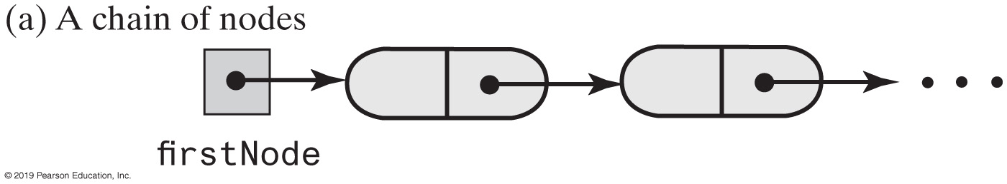
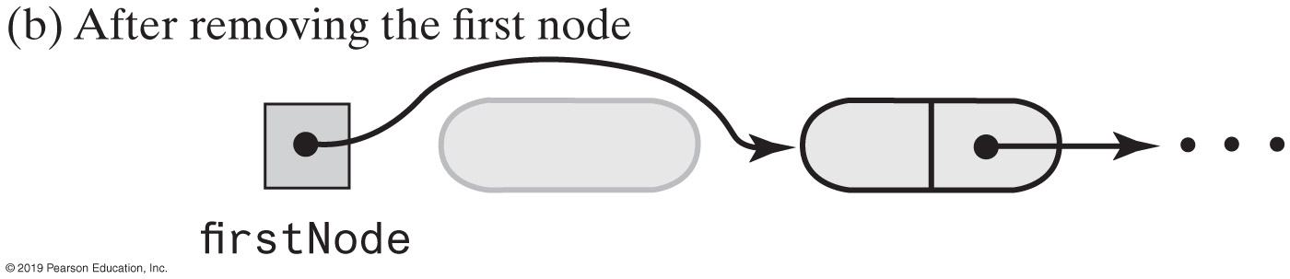
Removing the First Node

Slide 30
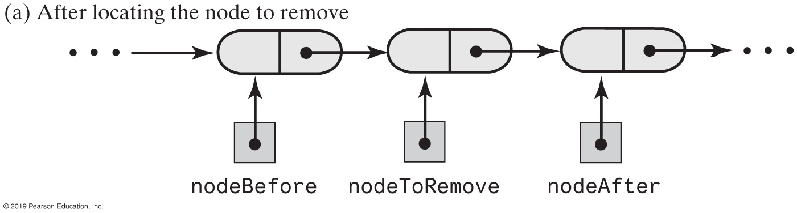
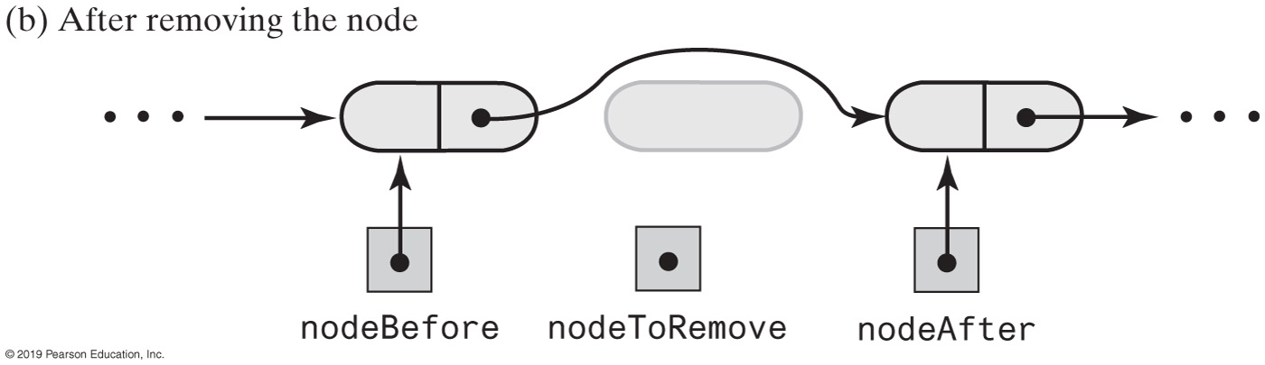
Removing an Interior Node

Slide 31
remove method returns entry it deletes from list
public T remove(int givenPosition)
{
T result = null; // Return value
if ((givenPosition >= 1) && (givenPosition <= numberOfEntries))
{
// Assertion: !isEmpty()
if (givenPosition == 1) // Case 1: Remove first entry
{
result = firstNode.getData(); // Save entry to be removed
firstNode = firstNode.getNextNode(); // Remove entry
}
else // Case 2: Not first entry
{
Node nodeBefore = getNodeAt(givenPosition - 1);
Node nodeToRemove = nodeBefore.getNextNode();
result = nodeToRemove.getData(); // Save entry to be removed
Node nodeAfter = nodeToRemove.getNextNode();
nodeBefore.setNextNode(nodeAfter); // Remove entry
} // end if
numberOfEntries--; // Update count
return result; // Return removed entry
}
else
throw new IndexOutOfBoundsException(
"Illegal position given to remove operation.");
} // end remove

Slide 32
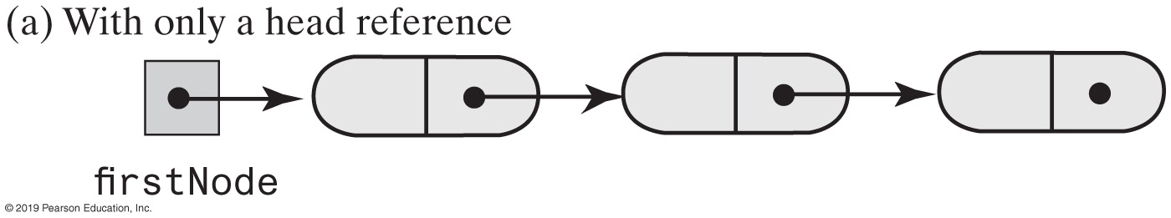
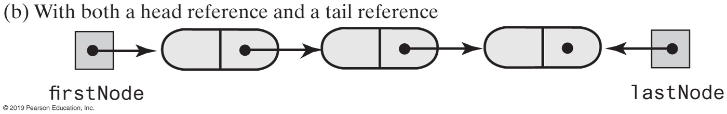
Using a Tail Reference
Two linked chains

Slide 33
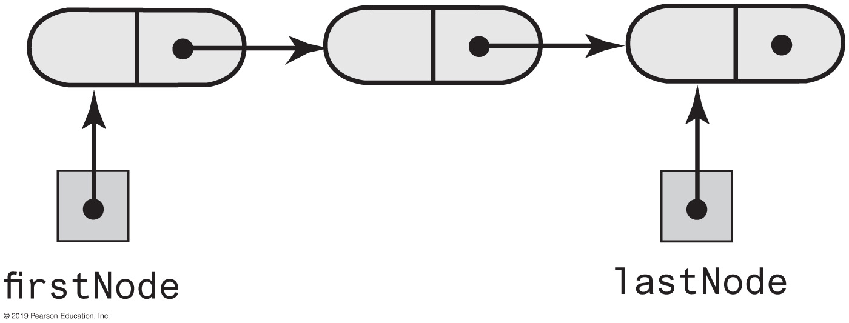
A Refined Linked Implementation
private Node firstNode; // Head reference to first node
private Node lastNode; // Tail reference to last node
private int numberOfEntries; // Number of entries in list
A linked chain with both a head reference and a tail reference

Slide 34
Efficiency of Using a Chain
Operation | Alist | LList | LListWithTail
add(newEntry) | O(1) | O(n) | O(1)
add(givenPosition, newEntry) | O(n); O(n); O(1) | O(1); O(n) | O(1); O(n); O(1)
toArray() | O(n) | O(n) | O(n)
remove(givenPosition) | O(n); O(n); O(1) | O(1); O(n) | O(1); O(n)
replace(givenPosition, newEntry) | O(1) | O(1); O(n) | O(1); O(n); O(1)
getEntry(givenPosition) | O(1) | O(1); O(n) | O(1); O(n); O(1)
contains(anEntry) | O(n) | O(n) | O(n)
clear(), getLength(), isEmpty() | O(1) | O(1) | O(1)
The time efficiencies of the ADT list operations for three implementations, expressed in Big Oh notation

Slide 35
Method toArray
public T[] toArray()
{
// The cast is safe because the new array contains null entries
@SuppressWarnings("unchecked")
T[] result = (T[])new Object[numberOfEntries];
int index = 0;
Node currentNode = firstNode;
while ((index < numberOfEntries) && (currentNode != null))
{
result[index] = currentNode.getData();
currentNode = currentNode.getNextNode();
index++;
} // end while
return result;
} // end toArray
Traverses chain, loads an array

Slide 36
Interface List (Java Class Library)
public void add(int index, T newEntry)
public T remove(int index)
public void clear()
public T set(int index, T anEntry) // Like replace
public T get(int index) // Like getEntry
public boolean contains(Object anEntry)
public int size() // Like getLength
public boolean isEmpty()
https://docs.oracle.com/javase/8/docs/api/java/util/List.html

Slide 37
Class ArrayList (Java Class Library)
Available constructors
public ArrayList()
public ArrayList(int initialCapacity)
Similar to java.util.vector
Can use either ArrayList or Vector as an implementation of the interface List

Slide 38
Class LinkedList (Java Class Library)
Implements the interface List
LinkedList defines more methods than are in the interface List
You can use the class LinkedList as implementation of ADT
queue
deque
or list

Slide 39
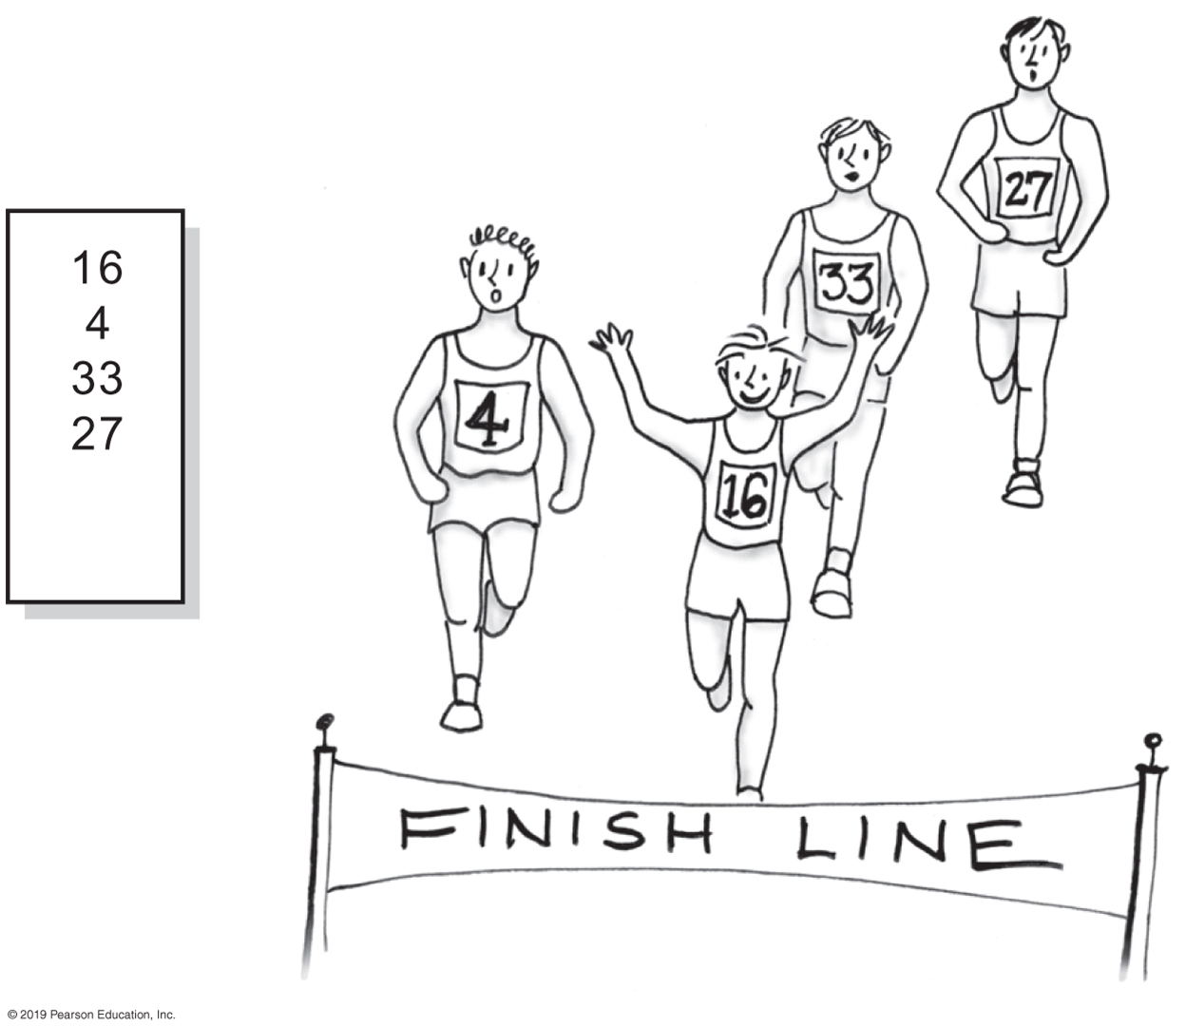
Activity | Using the ADT List
A list of numbers that identify runners in the order in which they finished

Slide 40
Using the ADT List
/** A driver that uses a list to track the
runners in a race as they cross the finish line. */
public class RoadRace {
public static void main(String[] args) {
recordWinners();
} // end main
public static void recordWinners() {
ListInterface<String> runnerList = new AList<>();
// runnerList has only methods in ListInterface
runnerList.add("16"); // Winner
runnerList.add(" 4"); // Second place
runnerList.add("33"); // Third place
runnerList.add("27"); // Fourth place
displayList(runnerList);
} // end recordWinners
public static void displayList(ListInterface<String> list) {
int numberOfEntries = list.getLength();
System.out.println("The list contains " + numberOfEntries +
" entries, as follows:");
for (int position = 1; position <= numberOfEntries; position++)
System.out.println(list.getEntry(position) +
" is entry " + position);
System.out.println();
} // end displayList
} // end RoadRace
Program Output
The list contains 4 entries,
as follows:
16 is entry 1
4 is entry 2
33 is entry 3
27 is entry 4
Notes:
A client of a class that implements ListInterface

Slide 41
Using the ADT List
// Make an alphabetical list of names as students enter a room
ListInterface<String> alphaList = new AList<>();
alphaList.add(1, "Amy"); // Amy
alphaList.add(2, "Elias"); // Amy Elias
alphaList.add(2, "Bob"); // Amy Bob Elias
alphaList.add(3, "Drew"); // Amy Bob Drew Elias
alphaList.add(1, "Aaron"); // Aaron Amy Bob Drew Elias
alphaList.add(4, "Carol"); // Aaron Amy Bob Carol Drew Elias

Slide 42
Using the ADT List
// Make a list of names as you think of them
ListInterface<Name> nameList = new AList<>();
Name amy = new Name("Amy", "Smith");
nameList.add(amy);
nameList.add(new Name("Tina", "Drexel");
nameList.add(new Name("Robert", "Jones");
Name secondName = nameList.getEntry(2);
A list of Name objects, rather than String

